Slide 1

Anti-counterfeiting and product authentication system

Slide 2




PROBLEM
+$500B
PER YEAR WORLDWIDE
The illicit trade in counterfeits moves massive amounts of money, hurting economies and supply chains worldwide.
Sources: OECD / EUIPO – Trends in Trade in Counterfeit and Pirated Goods.

Slide 3
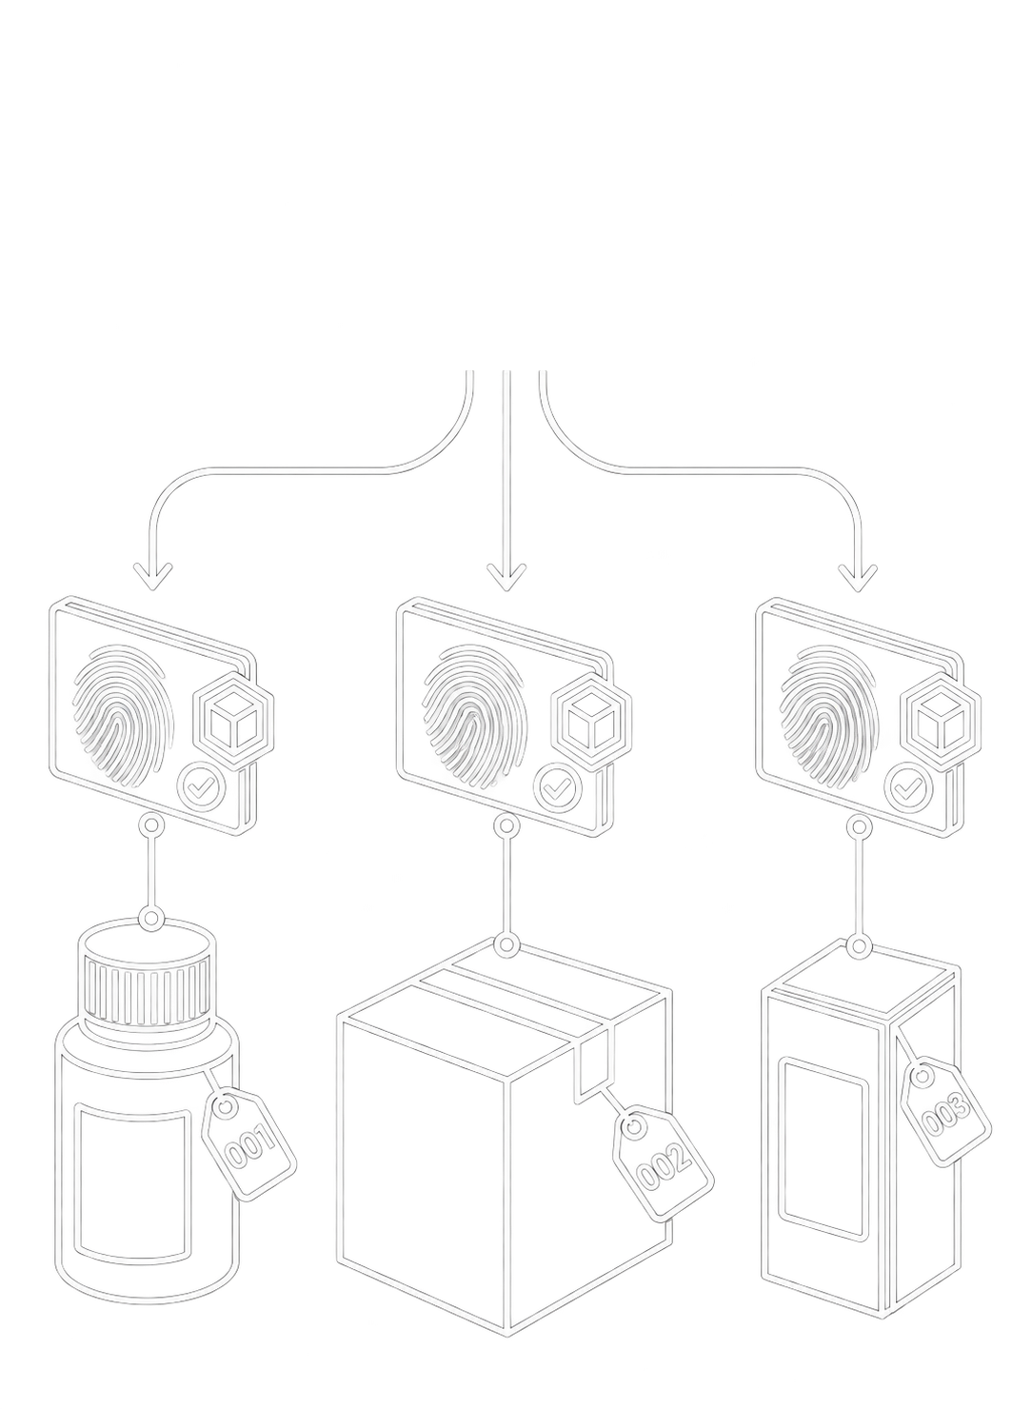
OUR SOLUTION
Product tokenization
A unique identity for every item
Link your physical goods to unforgeable digital tokens backed by the Solana network.

Slide 4
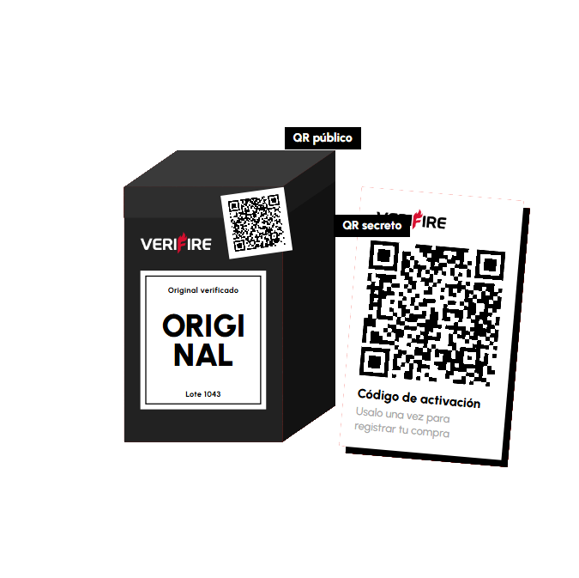
OUR SOLUTION
ONE TOKEN, TWO QR
One public and one secret
Key information for the buyer and the peace of mind of an original product

Slide 5
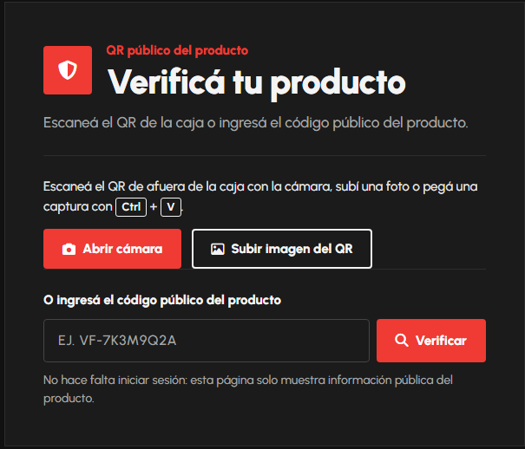
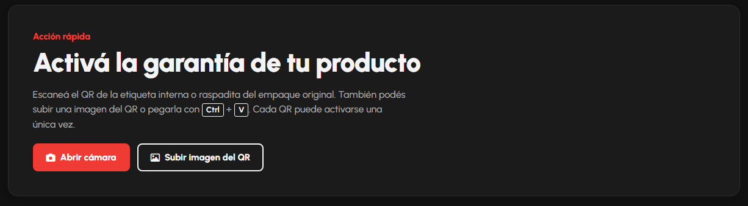
OUR SOLUTION
Claim your product
It will be yours and only yours
Plus other features such as activating warranties with the same claim

Slide 6
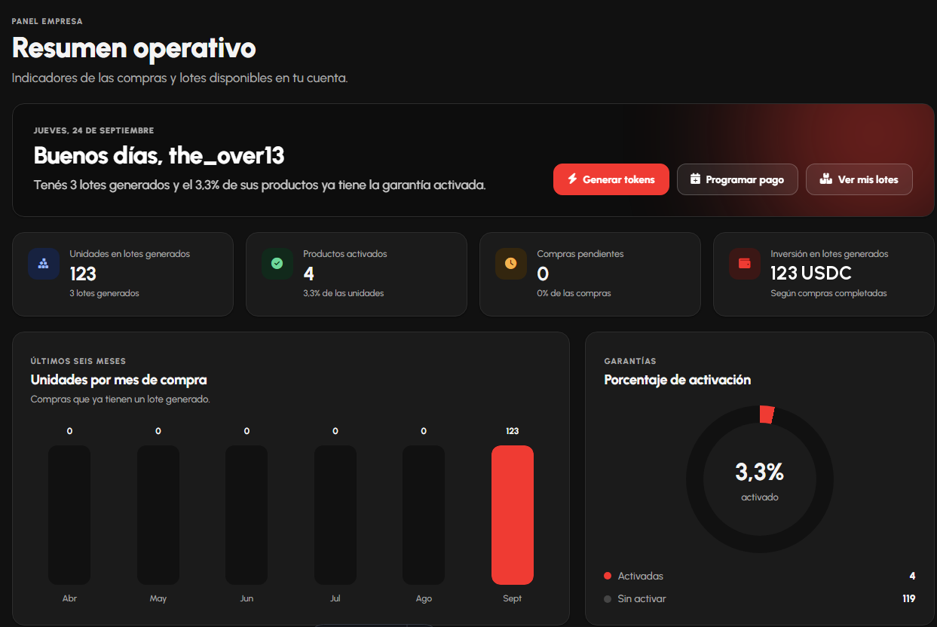
OUR SOLUTION
Verifire for companies
a workspace built for companies, with better and more detailed tools

Slide 7
BUSINESS MODEL
B2B fee per registered product
SELLING PRICE
0.025 - 0.25
Range per unit (USD)
B2B fee that scales with each customer’s registration volume.
OPERATING COST
< $0.003
Solana network fee
Minimal transaction cost

Slide 8
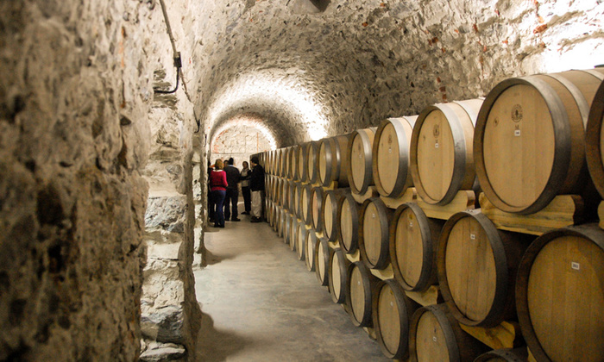
GO-TO-MARKET STRATEGY
Entry and scaling strategy
1. TRIGGER
INV 2026
Regulation
Mandatory lot traceability for exports.
2. PILOT (SALTA)
Cafayate
Validation
Face-to-face validation with local wineries.
3. SCALE
Brands
Expansion
Mass distribution and large manufacturers.

Slide 9
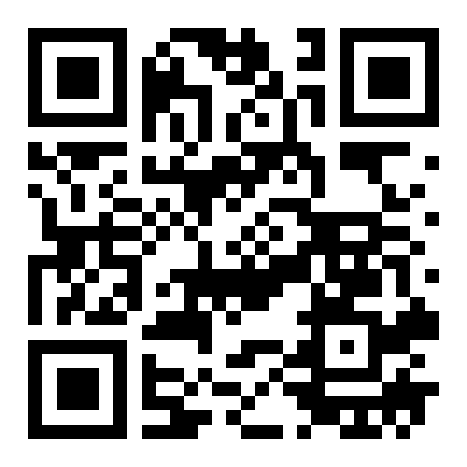
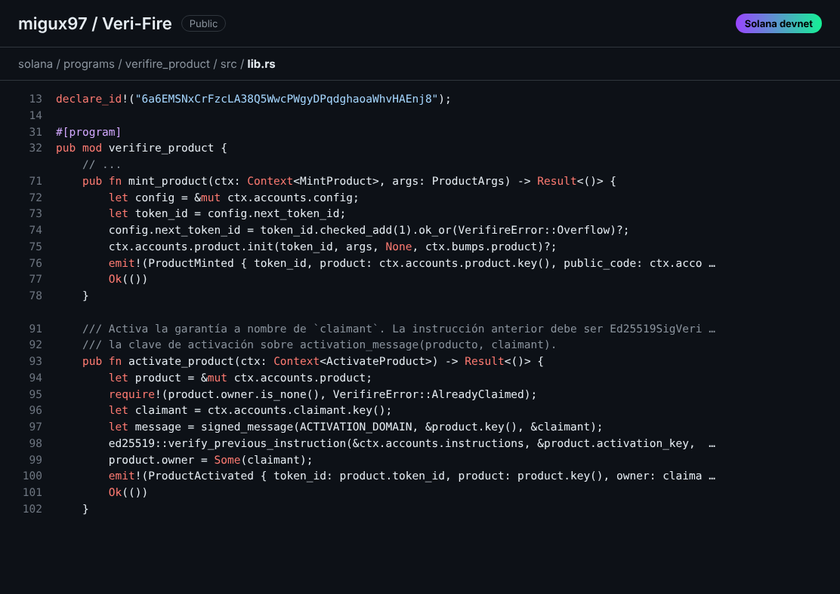
Github

Slide 10
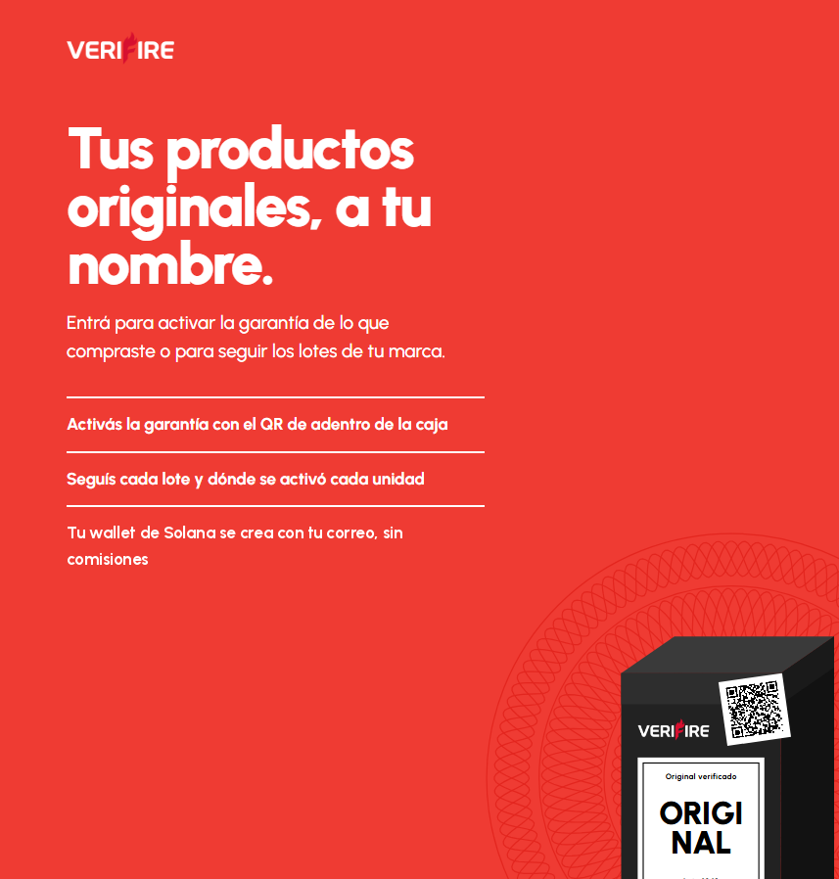
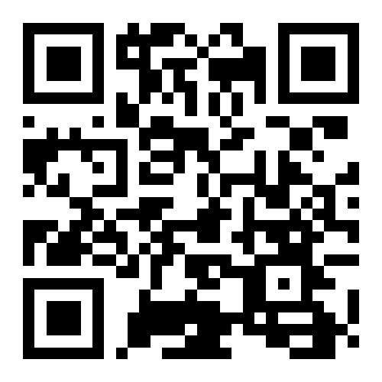
Demo Link

Slide 11
Thank you!

